Slide 1
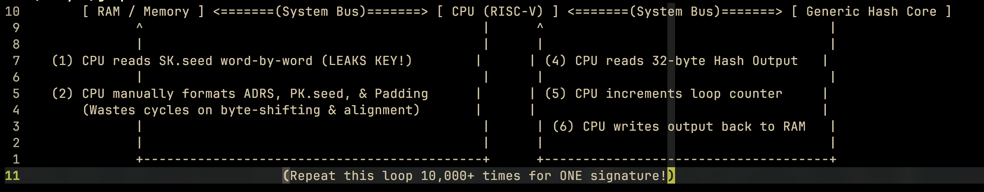
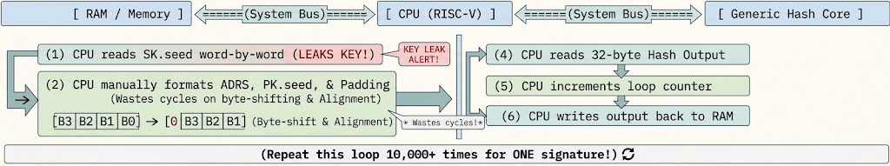
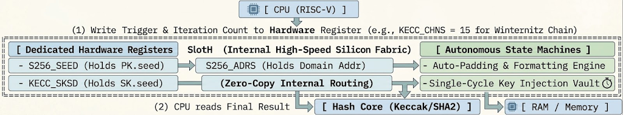
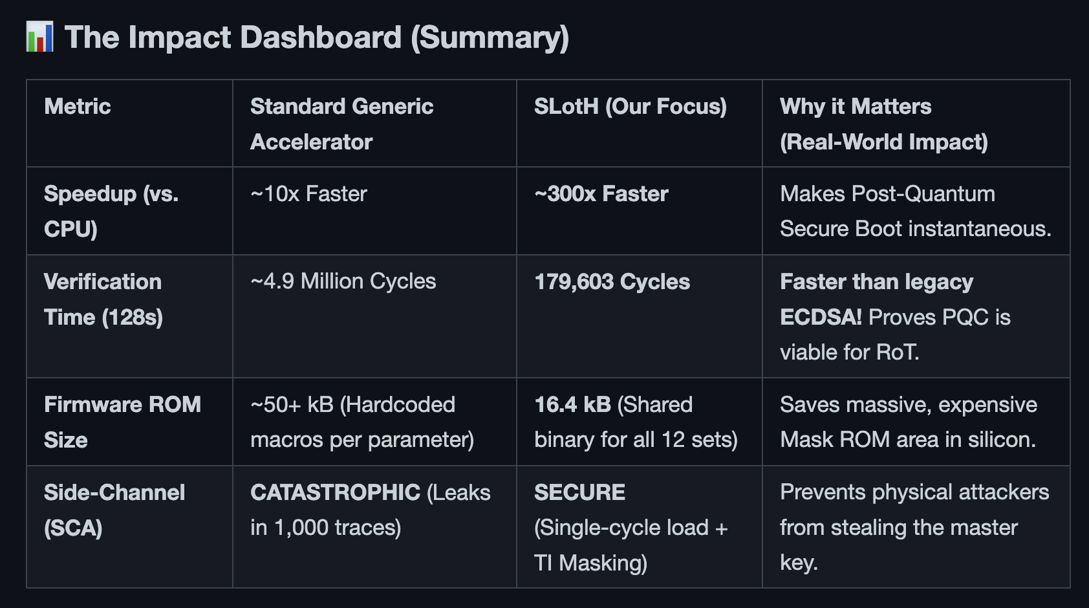
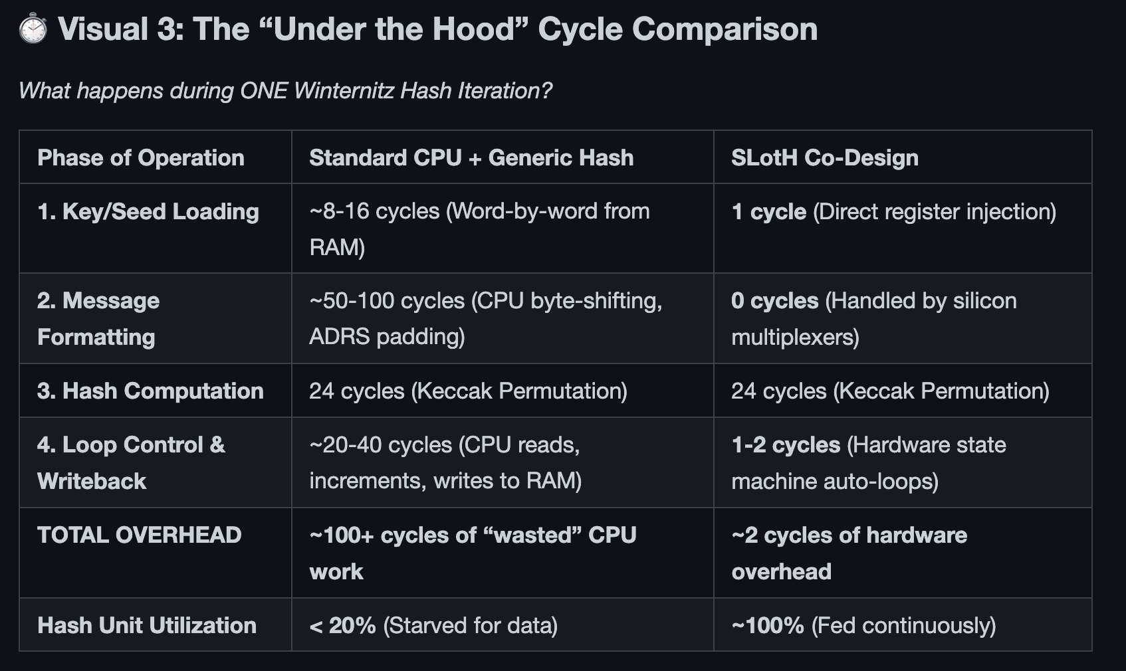
Quanta Correspondent
Accelerating SLH-DSA by Two Orders of Magnitude with a Single Hash Unit
Standard SLH-DSA Method
SLotH
Investigating Side-Channel Attack (SCA) Resistance and Threshold Implementation (TI) in Post-Quantum Hash-Based Signature: SLH-DSA.
▬▬▬▬▬▬▬▬▬▬▬▬▬▬▬▬▬▬▬
By Adiyat Abubakirov, Tina Carter, and Justin Williams
Notes:
> SLH-DSA (Stateless Hash-Based Digital Signature Standard): hash signature standard // what this paper is iterating on
> RoT (root of trust) units provide cryptographic functions (for SoC): SECURE BOOT&PLATFORM SECURITY as well as digital SIGNATURE generation and VERIFICATION
> compute units independent/isolated from main CPU/GPUs
> (US gov. has made) firmware signature verification priority for "Post-Quantum Cryptography" security
> this is a main function of RoC units
This paper provides:
Analysis of SLH-DSA's suitability for RoC use
Description of open source hardware (ELEPHANT) to accelerate ^'s when used in RoC applications
Shows the acceleration (10-100x depending on what you measure against)

Slide 2
Intellectual Merit
Problem:
New standard for quantum-resistant digital signatures (SLH-DSA - Stateless Hash-Based Digital Signature Standard) is slow on standard computers.
Requires millions of repetitive, heavy hash calculations (Winternitz chains) & complex message formatting.
Why it matters:
Quantum computers are approaching and standard chips’ security is unable to protect from quantum computers.
Contributions:
Authors build SLotH, a custom hardware accelerator that completely automates the algorithm's repetitive "grunt work" (like message padding and chaining).
100x to 300x speedup compared to standard methods.
ISSUE: Standard software secretly leaks its master key via power consumption.
Successfully engineered a hardware shield (Threshold Implementation) to block the leak.
Notes:
Algorithm-Hardware Co-design is Critical for Post-Quantum Cryptography: The results imply that just dropping a general-purpose high-performance hash core into a system is not enough for hash-based signature systems. At least orders of magnitude (perhaps 100x) better performance is obtained by exposing the details of the algorithm, such as Winternitz chaining, and by doing iterative padding and key-management at the silicon level.
Serious Software Side-Channel Attack: The results provide significant experimental results and demonstrate that the software SNH-DSA is severely affected in a malicious physical environment. Due to the high frequency of the master key (SK.seed) reuse in the call to the pseudorandom function (PRF), it will be quickly exposed to the CPU. And it can conclude that hardware key solation and masking are no more than optional requirements.
Challenging perceptions of Secure Boot: Quantitative evidence indicates accelerated SLH-DSA "s" variants are likely to be faster at signature verification than comparably-sized ECDSA or Dilithium accelerators. This runs counter to public perception, and provides strong evidence that "conservative" hash-based signatures are suitable for latency-sensitive firmware verification.
SLH-DSA'S Fault Resilience: The authors admit a major flaw in SLH-DSA signing is its exposure to fault injection. A faulty signature could be validated yet leak enough information to allow future signatures to be forged. This is especially valuable to hardware designers as it shows that simple post-signature validation is not sufficient and that hardware duplication and redundancy is an upgrade.

Slide 3
Impact
Our Progress
Background Research:
RoT for SoC; existing computer implementations of signature verification (with/without hash).
Coding Project Outline:
Core PRF Implementation
  SLH-DSA PRF (using SHAKE256) and the Winternitz chain iteration logic in Python.
  Verify against NIST Known Answer Tests (KATs) to ensure our cryptographic math is 100% compliant with FIPS 205
Leakage Modelling Engine
  The simulation engine that models power consumption
  Hamming Weight of the intermediate variables (which directly ties to the Abstract Algebra and GF(2) XOR operations we studied in Lectures 3 & 4).
  Model both the "leaky" CPU mode and the "protected" SLotH mode.
TVLA Statistical Framework
  Use Welch’s t-test to compare fixed and random key trace sets and plot to show t-value spikes as ‘critical value’ leaks
The paper sets up a great move in the right direction to maintain the integrity and security of firmware as we enter an age of quantum computing. Secure boot is a critical process to laptops, phones, and computers of all kinds, and firmware attacks on them could be devastating. The proposed ideas encourage further collaboration between hardware and software design when creating cryptographic capabilities. Additionally, the Hardware Accelerator built/talked about in the paper (SLotH), is open source, so anyone can collaborate, build, and improve on its functions.
We Are Here
Notes:
Foundation & PRF Implementation (use SK.seed to extend a Winternitz chain/implement hash signature verification in python simulation)
Leakage Simulation Engine ()
TVLA Analysis & Visualization (Welch's t-test for fixed and random key)
Demo & Presentation (visualize how TVLA stats change in real time with variable ‘CPU mode’, ‘SLotH mode,’ and ‘TI-masked mode’ imputs)

